Slide 1
Bank 2 The Futrue

Slide 2






Slide 3
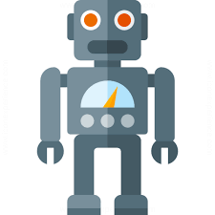


Slide 4


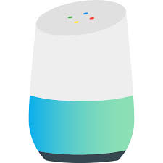




Slide 5

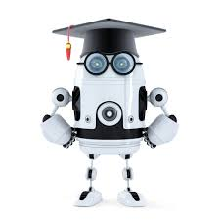
LUIS
BOT Framework
Machine Learning

Slide 6
AI is the new UI

